Slide 1
BUILDING THE GLOBAL RESILIENCE UNIVERSITY
Global Resilience through Youth Empowerment

Slide 2
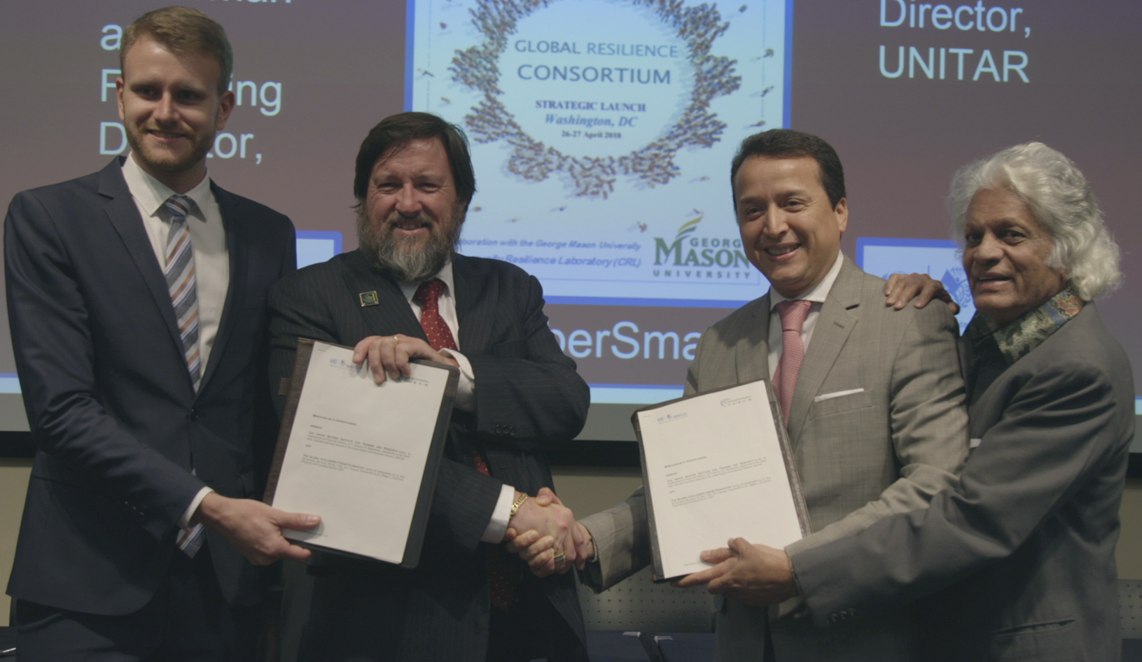
Global Resilience Consortium

Slide 3
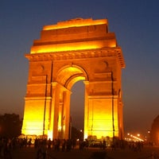
Fulfilling the “Delhi Proclamation”
Announced in New Delhi, India on 3 October 2018 in support of the 150thanniversary of Mahatma Gandhi’s birthday
The Conference concluded to raise beyond 2030 through integrated learning “One Million Youth Leaders for Global Sustainable Development” (1M2030)
Mission is to implement and carry forward UNSDGs goals beyond 2030 as the end state of sustainable development bottom-up approach to complement UN top-down approaches
Building toward the “Global Resilience University”

Slide 4
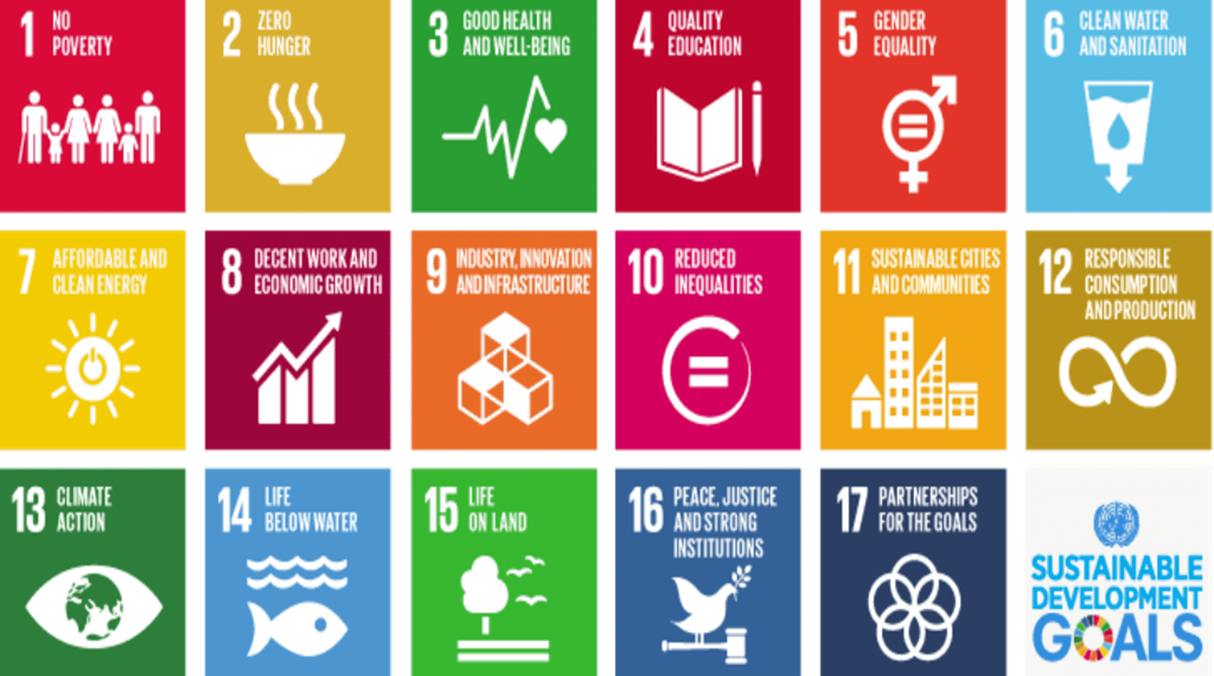
… To address the United Nations 17 Sustainable Development Goals
To build trustworthy collaborative relationships in unity of effort through communities of practice

Slide 5
… Leading to a Global Resilience University

